Slide 1
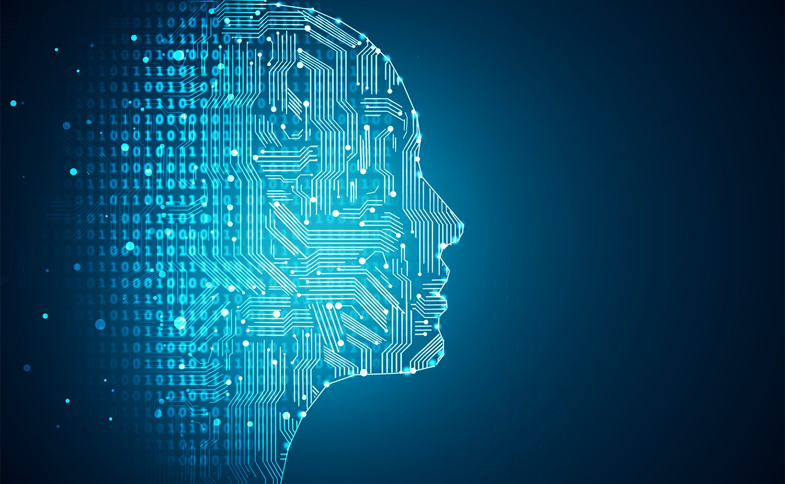

PREDICTIVE ANALYTICS
ML Algorithms for Diabetes Prediction
Nikhil Agarwal (MS BA Spring 2021)
Apr 2021

Slide 2
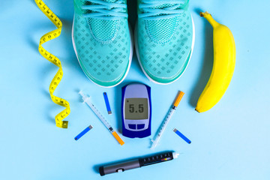
TABLE OF CONTENTS
1
DIABETES SNAPSHOT
2
DIABETES DATASET & ML ALGORITHMS OVERVIEW
3
NAÏVE BAYES ALGORITHM
4
KNN ALGORITHM

Slide 3







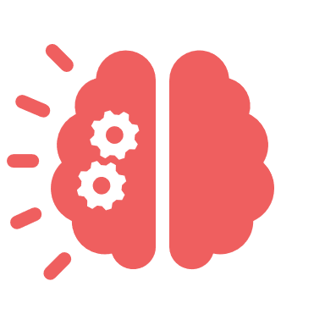



DIABETES SNAPSHOT
According to WebMD, Diabetes is a disease that involve problems with the hormone insulin produced by Pancreas. Diabetes can occur when the pancreas produces very little or no insulin, or when the body does not respond appropriately to insulin
DIABETES
OVERVIEW
As of Apr 2021, there is no permanent cure for Diabetes and the patients need to manage their disease to remain healthy
Patient Population
Cost Associated with Diabetes
In 2018, 34.2 Million people had diabetes in the USA (around 10% of population)
Total medical costs and lost work and wages for people with diagnosed diabetes
US$ 327 MM
DIABETES in the USA
1 in 5 people don’t know that they have diabetes
Diabetic patients are at a higher risk of blindness, kidney failure, heart disease, stroke, and loss of toes
COMMON TYPES OF DIABETES
Type 1 Diabetes
Type 2 Diabetes
Body doesn’t make enough insulin
No known cure for prevention
Can develop at any age
Body can’t use insulin properly
Most cases can be prevented
Can develop at any age
18,000+ youth were diagnosed with type 1 diabetes each year in 2014 and 2015, while 6,000 youth were diagnosed for type 2 diabetes
Source: WebMD, CDC

Slide 4
TABLE OF CONTENTS
1
DIABETES SNAPSHOT
2
DIABETES DATASET ML ALGORITHMS OVERVIEW
3
NAÏVE BAYES ALGORITHM
4
KNN ALGORITHM

Slide 5
PIMA INDIANS DIABETES DATASET
DATASET OVERVIEW
The dataset is provided by the National Institute of Diabetes and Digestive and Kidney Diseases consisting of health data of females above 21 years old of Pima Indian Heritage. Dataset is sourced from Kaggle
The Dataset contains 768 observations, 9 columns (8 predictor variables and 1 class variables)
Column 1: Pregnancy (Number of times pregnant)
Column 2: Glucose (Plasma glucose concentration a 2 hours in an oral glucose tolerance test)
Column 3: BloodPressure (Diastolic blood pressure (mm Hg))
Column 4: SkinThickness (Triceps skin fold thickness (mm))
Column 5: Insulin (2-Hour serum insulin (mu U/ml))
Column 6: BMI (Body mass index (weight in kg/(height in m)^2))
Column 7: DiabetesPedigreeFunction (Diabetes pedigree function)
Column 8: Age (Years)
Column 9: Class Variable (class value 1 is interpreted as "tested positive for diabetes")
Source: Kaggle
Notes:
http://www.prnewswire.com/news-releases/patient-monitoring-devices-global-markets-300293102.html
http://www.marketsandmarkets.com/Market-Reports/patient-healthcare-monitoring-systems-devices-market-678.html
http://www.grandviewresearch.com/industry-analysis/digital-patient-monitoring-devices-market
http://www.census.gov/content/dam/Census/library/publications/2016/demo/p95-16-1.pdf
https://www.nia.nih.gov/newsroom/2016/03/worlds-older-population-grows-dramatically
http://americas.nttdata.com/Industries/Industries/Healthcare/~/media/Documents/White-Papers/Trends-in-Telehealth-White-Paper.pdf
https://globenewswire.com/news-release/2016/06/16/849108/0/en/Global-Patient-Monitoring-Equipment-Device-markets-to-reach-26-2-billion-by-2022-Making-a-market-resurgence-due-to-Modular-structure-ResearchMoz.html
http://www.prnewswire.com/news-releases/patient-monitoring-deviceequipmentsystem-market-worth-24762-million-usd-by-2020-565633001.html
http://www.24x7mag.com/2015/07/global-patient-monitoring-systems-market-worth-31-4-billion-report-estimates/
http://www.prnewswire.com/news-releases/patient-monitoring-deviceequipmentsystem-market-by-product-end-user---global-forecast-to-2020-300213927.html

Slide 6
PREDICTIVE ANALYTICS USING SUPERVISED LEARNING
ML Algorithms including Naive Bayes and KNN are supervised learning algorithms which can be used for classification and predictive analytics
NAIVE BAYES ALGORITHM
KNN (K Nearest Neighbours)
Naïve Bayes is a probabilistic ML algorithm based on the Bayes Theorem. It is used for wide variety of classification tasks (grouping certain observations under common segments)
The algorithm is based on Bayes Theorem for calculating the conditional probabilities.
The algorithm is generally used for sentiment analysis, recommendation systems, and spam filtering
KNN is a non-parametric classification model developed in 1951 by statisticians Evelyn Fix and Joseph Hodges. It can be used for both classification as well as regression
In classification problems, the KNN algorithm classifies an object using its class membership
KNN can be used for searching semantic same documents, detecting outliers, and for building recommendation systems
Source: KD Nuggets, Analytics Vidhya
Notes:
http://www.prnewswire.com/news-releases/patient-monitoring-devices-global-markets-300293102.html
http://www.marketsandmarkets.com/Market-Reports/patient-healthcare-monitoring-systems-devices-market-678.html
http://www.grandviewresearch.com/industry-analysis/digital-patient-monitoring-devices-market
http://www.census.gov/content/dam/Census/library/publications/2016/demo/p95-16-1.pdf
https://www.nia.nih.gov/newsroom/2016/03/worlds-older-population-grows-dramatically
http://americas.nttdata.com/Industries/Industries/Healthcare/~/media/Documents/White-Papers/Trends-in-Telehealth-White-Paper.pdf
https://globenewswire.com/news-release/2016/06/16/849108/0/en/Global-Patient-Monitoring-Equipment-Device-markets-to-reach-26-2-billion-by-2022-Making-a-market-resurgence-due-to-Modular-structure-ResearchMoz.html
http://www.prnewswire.com/news-releases/patient-monitoring-deviceequipmentsystem-market-worth-24762-million-usd-by-2020-565633001.html
http://www.24x7mag.com/2015/07/global-patient-monitoring-systems-market-worth-31-4-billion-report-estimates/
http://www.prnewswire.com/news-releases/patient-monitoring-deviceequipmentsystem-market-by-product-end-user---global-forecast-to-2020-300213927.html

Slide 7
TABLE OF CONTENTS
1
DIABETES SNAPSHOT
2
DIABETES DATASET ML ALGORITHMS OVERVIEW
3
NAÏVE BAYES ALGORITHM
4
KNN ALGORITHM

Slide 8
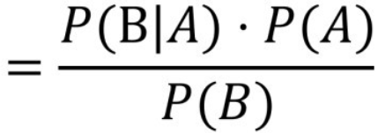
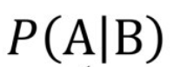
PREDICTIVE ANALYTICS USING SUPERVISED LEARNING
Naïve Bayes works on Bayes theorem and can be used to predict conditional probabilities for independent features
NAÏVE BAYES MODEL WORKING (1/2)
Principle: Naïve Bayes uses conditional probabilities (or posterior probabilities) given by
Model Assumptions: We make the following assumptions while deploying the Naïve Bayes Algorithm
Independency: We assume that all features in the dataset are independent to each other
Equality (Importance): All features have the same influence or importance in the model. None of the features are irrelevant and assumed to be contributing equally to the outcome
Source: KD Nuggets, Analytics Vidhya
Notes:
http://www.prnewswire.com/news-releases/patient-monitoring-devices-global-markets-300293102.html
http://www.marketsandmarkets.com/Market-Reports/patient-healthcare-monitoring-systems-devices-market-678.html
http://www.grandviewresearch.com/industry-analysis/digital-patient-monitoring-devices-market
http://www.census.gov/content/dam/Census/library/publications/2016/demo/p95-16-1.pdf
https://www.nia.nih.gov/newsroom/2016/03/worlds-older-population-grows-dramatically
http://americas.nttdata.com/Industries/Industries/Healthcare/~/media/Documents/White-Papers/Trends-in-Telehealth-White-Paper.pdf
https://globenewswire.com/news-release/2016/06/16/849108/0/en/Global-Patient-Monitoring-Equipment-Device-markets-to-reach-26-2-billion-by-2022-Making-a-market-resurgence-due-to-Modular-structure-ResearchMoz.html
http://www.prnewswire.com/news-releases/patient-monitoring-deviceequipmentsystem-market-worth-24762-million-usd-by-2020-565633001.html
http://www.24x7mag.com/2015/07/global-patient-monitoring-systems-market-worth-31-4-billion-report-estimates/
http://www.prnewswire.com/news-releases/patient-monitoring-deviceequipmentsystem-market-by-product-end-user---global-forecast-to-2020-300213927.html

Slide 9
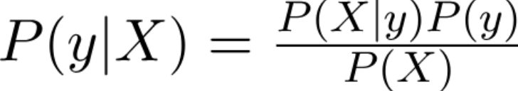
PREDICTIVE ANALYTICS USING SUPERVISED LEARNING
NAÏVE BAYES MODEL WORKING (2/2)
Probability of an event y by predictor features X1, X2, X3,…Xn then our conditional probability would be
In Naive Bayes, we assume that the denominator remains constant, therefore conditional probability is equivalent to
The class variable y is calculated with maximum probability
Source: KD Nuggets, Analytics Vidhya
Notes:
http://www.prnewswire.com/news-releases/patient-monitoring-devices-global-markets-300293102.html
http://www.marketsandmarkets.com/Market-Reports/patient-healthcare-monitoring-systems-devices-market-678.html
http://www.grandviewresearch.com/industry-analysis/digital-patient-monitoring-devices-market
http://www.census.gov/content/dam/Census/library/publications/2016/demo/p95-16-1.pdf
https://www.nia.nih.gov/newsroom/2016/03/worlds-older-population-grows-dramatically
http://americas.nttdata.com/Industries/Industries/Healthcare/~/media/Documents/White-Papers/Trends-in-Telehealth-White-Paper.pdf
https://globenewswire.com/news-release/2016/06/16/849108/0/en/Global-Patient-Monitoring-Equipment-Device-markets-to-reach-26-2-billion-by-2022-Making-a-market-resurgence-due-to-Modular-structure-ResearchMoz.html
http://www.prnewswire.com/news-releases/patient-monitoring-deviceequipmentsystem-market-worth-24762-million-usd-by-2020-565633001.html
http://www.24x7mag.com/2015/07/global-patient-monitoring-systems-market-worth-31-4-billion-report-estimates/
http://www.prnewswire.com/news-releases/patient-monitoring-deviceequipmentsystem-market-by-product-end-user---global-forecast-to-2020-300213927.html

Slide 10
PREDICTIVE ANALYTICS USING SUPERVISED LEARNING
NAÏVE BAYES MODEL SHORT EXAMPLE (1/2)
S.No. | Color | Type | Origin | Stolen (Y/N)
1 | Red | Sports | Domestic | Yes
2 | Red | Sports | Domestic | No
3 | Red | Sports | Domestic | Yes
4 | Yellow | Sports | Domestic | No
5 | Yellow | Sports | Imported | Yes
6 | Yellow | SUV | Imported | No
7 | Yellow | SUV | Imported | Yes
8 | Yellow | SUV | Domestic | No
9 | Red | SUV | Imported | No
10 | Red | Sports | Imported | Yes
We need to classify whether the car is stolen, given the features of the car (color, type, origin)
Assumptions: In the dataset all features are assumed to be independent. All features are equally important
 |  | Stolen
 |  | Yes | No
Color | Red | 3 | 2
 | Yellow | 2 | 3
 |  | Stolen
 |  | P (Yes) | P (No)
Color | Red | 3 / 5 | 2 / 5
 | Yellow | 2 / 5 | 3 / 5
Frequency Table
Likelihood Table
Source: KD Nuggets, Analytics Vidhya
Notes:
http://www.prnewswire.com/news-releases/patient-monitoring-devices-global-markets-300293102.html
http://www.marketsandmarkets.com/Market-Reports/patient-healthcare-monitoring-systems-devices-market-678.html
http://www.grandviewresearch.com/industry-analysis/digital-patient-monitoring-devices-market
http://www.census.gov/content/dam/Census/library/publications/2016/demo/p95-16-1.pdf
https://www.nia.nih.gov/newsroom/2016/03/worlds-older-population-grows-dramatically
http://americas.nttdata.com/Industries/Industries/Healthcare/~/media/Documents/White-Papers/Trends-in-Telehealth-White-Paper.pdf
https://globenewswire.com/news-release/2016/06/16/849108/0/en/Global-Patient-Monitoring-Equipment-Device-markets-to-reach-26-2-billion-by-2022-Making-a-market-resurgence-due-to-Modular-structure-ResearchMoz.html
http://www.prnewswire.com/news-releases/patient-monitoring-deviceequipmentsystem-market-worth-24762-million-usd-by-2020-565633001.html
http://www.24x7mag.com/2015/07/global-patient-monitoring-systems-market-worth-31-4-billion-report-estimates/
http://www.prnewswire.com/news-releases/patient-monitoring-deviceequipmentsystem-market-by-product-end-user---global-forecast-to-2020-300213927.html

Slide 11
PREDICTIVE ANALYTICS USING SUPERVISED LEARNING
NAÏVE BAYES MODEL SHORT EXAMPLE (2/2)
 |  | Stolen
 |  | P (Yes) | P (No)
Origin | Domestic | 2/5 | 3/5
 | Imported | 3/5 | 2/5
In this case need to find whether the car is stolen given it is Red Domestic, and SUV
P(Yes | X) = P(Red | Yes) * P(SUV | Yes) * P(Domestic | Yes) * P(Yes)
= 3/5 * 1/5 * 2/5 * 1
= 0.048
 |  | Stolen
 |  | P (Yes) | P (No)
Type | Sports | 4/5 | 2/5
 | SUV | 1/5 | 3/5
P(No | X) = P(Red | No) * P(SUV | No) * P(Domestic | No) * P(No)
= 2/5 * 3/5 * 3/5 * 1
= 0.144
In this case, P(No | X) > P (Yes | X); therefore, given the features Red, SUV, and Domestic, the car is classified as not stolen
Source: KD Nuggets, Analytics Vidhya
Notes:
http://www.prnewswire.com/news-releases/patient-monitoring-devices-global-markets-300293102.html
http://www.marketsandmarkets.com/Market-Reports/patient-healthcare-monitoring-systems-devices-market-678.html
http://www.grandviewresearch.com/industry-analysis/digital-patient-monitoring-devices-market
http://www.census.gov/content/dam/Census/library/publications/2016/demo/p95-16-1.pdf
https://www.nia.nih.gov/newsroom/2016/03/worlds-older-population-grows-dramatically
http://americas.nttdata.com/Industries/Industries/Healthcare/~/media/Documents/White-Papers/Trends-in-Telehealth-White-Paper.pdf
https://globenewswire.com/news-release/2016/06/16/849108/0/en/Global-Patient-Monitoring-Equipment-Device-markets-to-reach-26-2-billion-by-2022-Making-a-market-resurgence-due-to-Modular-structure-ResearchMoz.html
http://www.prnewswire.com/news-releases/patient-monitoring-deviceequipmentsystem-market-worth-24762-million-usd-by-2020-565633001.html
http://www.24x7mag.com/2015/07/global-patient-monitoring-systems-market-worth-31-4-billion-report-estimates/
http://www.prnewswire.com/news-releases/patient-monitoring-deviceequipmentsystem-market-by-product-end-user---global-forecast-to-2020-300213927.html

Slide 12


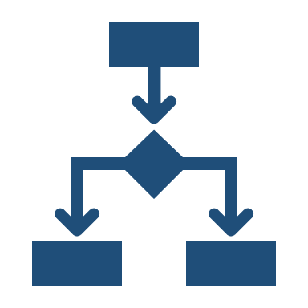
PREDICTIVE ANALYTICS USING SUPERVISED LEARNING
NAÏVE BAYES MODEL ON DIABETES DATASET: STEPS INVOLVED
Data Preparation and Model Deployment
Estimate Model Efficiency and Prediction
Data Cleaning
Check for Missing Values
Check for Null Values and replace them by column average
Convert labels as factor variables
Split the dataset into training and testing dataset (80:20 split)
Deploy the model using naïve_bayes() in R on the training dataset
Check the accuracy of the model by using the model on the testing dataset and calculate efficiency using confusion matrix / crosstabs
Predict more class labels if the accuracy is acceptable
Source: KD Nuggets, Analytics Vidhya
Notes:
http://www.prnewswire.com/news-releases/patient-monitoring-devices-global-markets-300293102.html
http://www.marketsandmarkets.com/Market-Reports/patient-healthcare-monitoring-systems-devices-market-678.html
http://www.grandviewresearch.com/industry-analysis/digital-patient-monitoring-devices-market
http://www.census.gov/content/dam/Census/library/publications/2016/demo/p95-16-1.pdf
https://www.nia.nih.gov/newsroom/2016/03/worlds-older-population-grows-dramatically
http://americas.nttdata.com/Industries/Industries/Healthcare/~/media/Documents/White-Papers/Trends-in-Telehealth-White-Paper.pdf
https://globenewswire.com/news-release/2016/06/16/849108/0/en/Global-Patient-Monitoring-Equipment-Device-markets-to-reach-26-2-billion-by-2022-Making-a-market-resurgence-due-to-Modular-structure-ResearchMoz.html
http://www.prnewswire.com/news-releases/patient-monitoring-deviceequipmentsystem-market-worth-24762-million-usd-by-2020-565633001.html
http://www.24x7mag.com/2015/07/global-patient-monitoring-systems-market-worth-31-4-billion-report-estimates/
http://www.prnewswire.com/news-releases/patient-monitoring-deviceequipmentsystem-market-by-product-end-user---global-forecast-to-2020-300213927.html

Slide 13
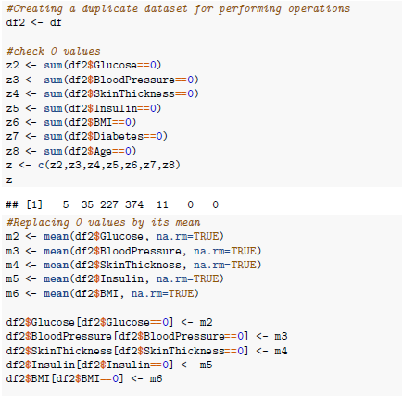
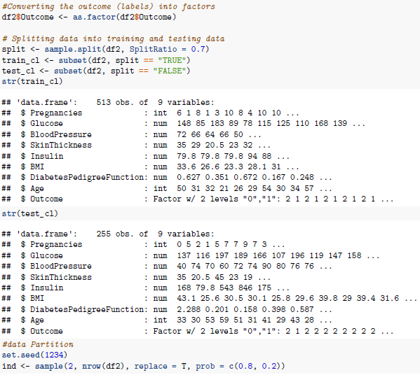
PREDICTIVE ANALYTICS USING SUPERVISED LEARNING
NAÏVE BAYES MODEL ON DIABETES DATASET: R CODE (1/3)
Notes:
http://www.prnewswire.com/news-releases/patient-monitoring-devices-global-markets-300293102.html
http://www.marketsandmarkets.com/Market-Reports/patient-healthcare-monitoring-systems-devices-market-678.html
http://www.grandviewresearch.com/industry-analysis/digital-patient-monitoring-devices-market
http://www.census.gov/content/dam/Census/library/publications/2016/demo/p95-16-1.pdf
https://www.nia.nih.gov/newsroom/2016/03/worlds-older-population-grows-dramatically
http://americas.nttdata.com/Industries/Industries/Healthcare/~/media/Documents/White-Papers/Trends-in-Telehealth-White-Paper.pdf
https://globenewswire.com/news-release/2016/06/16/849108/0/en/Global-Patient-Monitoring-Equipment-Device-markets-to-reach-26-2-billion-by-2022-Making-a-market-resurgence-due-to-Modular-structure-ResearchMoz.html
http://www.prnewswire.com/news-releases/patient-monitoring-deviceequipmentsystem-market-worth-24762-million-usd-by-2020-565633001.html
http://www.24x7mag.com/2015/07/global-patient-monitoring-systems-market-worth-31-4-billion-report-estimates/
http://www.prnewswire.com/news-releases/patient-monitoring-deviceequipmentsystem-market-by-product-end-user---global-forecast-to-2020-300213927.html

Slide 14
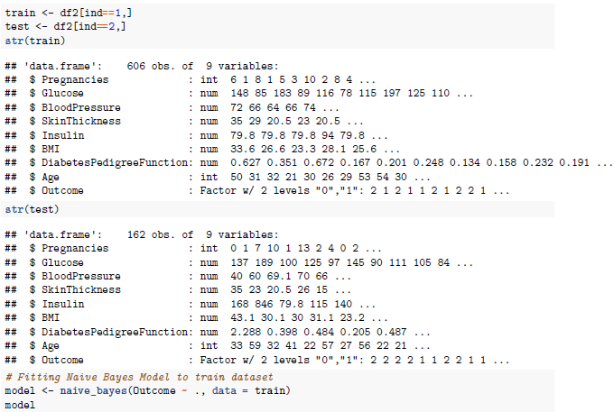
PREDICTIVE ANALYTICS USING SUPERVISED LEARNING
NAÏVE BAYES MODEL ON DIABETES DATASET: R CODE (2/3)
Notes:
http://www.prnewswire.com/news-releases/patient-monitoring-devices-global-markets-300293102.html
http://www.marketsandmarkets.com/Market-Reports/patient-healthcare-monitoring-systems-devices-market-678.html
http://www.grandviewresearch.com/industry-analysis/digital-patient-monitoring-devices-market
http://www.census.gov/content/dam/Census/library/publications/2016/demo/p95-16-1.pdf
https://www.nia.nih.gov/newsroom/2016/03/worlds-older-population-grows-dramatically
http://americas.nttdata.com/Industries/Industries/Healthcare/~/media/Documents/White-Papers/Trends-in-Telehealth-White-Paper.pdf
https://globenewswire.com/news-release/2016/06/16/849108/0/en/Global-Patient-Monitoring-Equipment-Device-markets-to-reach-26-2-billion-by-2022-Making-a-market-resurgence-due-to-Modular-structure-ResearchMoz.html
http://www.prnewswire.com/news-releases/patient-monitoring-deviceequipmentsystem-market-worth-24762-million-usd-by-2020-565633001.html
http://www.24x7mag.com/2015/07/global-patient-monitoring-systems-market-worth-31-4-billion-report-estimates/
http://www.prnewswire.com/news-releases/patient-monitoring-deviceequipmentsystem-market-by-product-end-user---global-forecast-to-2020-300213927.html

Slide 15
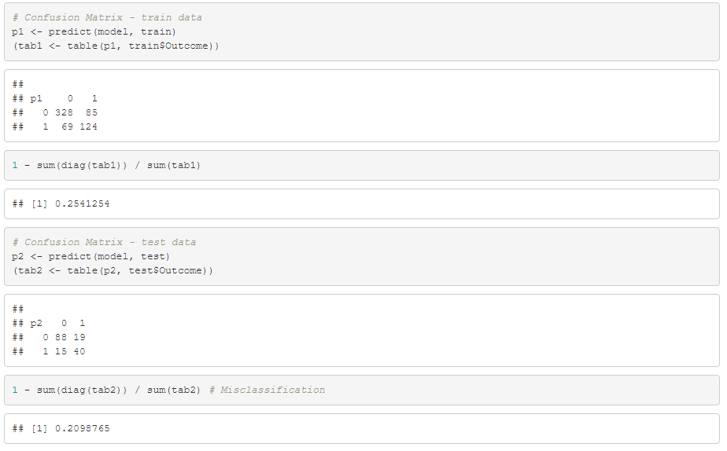
PREDICTIVE ANALYTICS USING SUPERVISED LEARNING
NAÏVE BAYES MODEL ON DIABETES DATASET: R CODE (3/3)
Misclassification error = 20.9%
Notes:
http://www.prnewswire.com/news-releases/patient-monitoring-devices-global-markets-300293102.html
http://www.marketsandmarkets.com/Market-Reports/patient-healthcare-monitoring-systems-devices-market-678.html
http://www.grandviewresearch.com/industry-analysis/digital-patient-monitoring-devices-market
http://www.census.gov/content/dam/Census/library/publications/2016/demo/p95-16-1.pdf
https://www.nia.nih.gov/newsroom/2016/03/worlds-older-population-grows-dramatically
http://americas.nttdata.com/Industries/Industries/Healthcare/~/media/Documents/White-Papers/Trends-in-Telehealth-White-Paper.pdf
https://globenewswire.com/news-release/2016/06/16/849108/0/en/Global-Patient-Monitoring-Equipment-Device-markets-to-reach-26-2-billion-by-2022-Making-a-market-resurgence-due-to-Modular-structure-ResearchMoz.html
http://www.prnewswire.com/news-releases/patient-monitoring-deviceequipmentsystem-market-worth-24762-million-usd-by-2020-565633001.html
http://www.24x7mag.com/2015/07/global-patient-monitoring-systems-market-worth-31-4-billion-report-estimates/
http://www.prnewswire.com/news-releases/patient-monitoring-deviceequipmentsystem-market-by-product-end-user---global-forecast-to-2020-300213927.html

Slide 16
TABLE OF CONTENTS
1
DIABETES SNAPSHOT
2
DIABETES DATASET ML ALGORITHMS OVERVIEW
3
NAÏVE BAYES ALGORITHM
4
KNN ALGORITHM

Slide 17
PREDICTIVE ANALYTICS USING SUPERVISED LEARNING
KNN MODEL WORKING & EXAMPLE (1/2)
Principle: KNN algorithm stores all available cases and classifies new cases by a majority vote of its k neighbors. This algorithms segregates unlabeled data points into well defined groups. We can use KNN to classify an unlabeled example into one of the several labeled groups
KNN uses distance between various points for calculating the proximity of the points to the already identified label
Dataset Example
Drink | Sweetness | Fizziness | Type Of Drink
RedBull | 8 | 8 | Energy Drink
Tropicana | 9 | 1 | Health Drink
Pepsi | 4 | 8 | Soft Drink
Vodka | 2 | 1 | Hard Drink
We have a table of various drinks which are labeled as Energy Drink, Health Drink, Soft Drink, or Hard Drink.
There are multiple features including Sweetness and Fizziness
Source: KD Nuggets, Analytics Vidhya
Notes:
http://www.prnewswire.com/news-releases/patient-monitoring-devices-global-markets-300293102.html
http://www.marketsandmarkets.com/Market-Reports/patient-healthcare-monitoring-systems-devices-market-678.html
http://www.grandviewresearch.com/industry-analysis/digital-patient-monitoring-devices-market
http://www.census.gov/content/dam/Census/library/publications/2016/demo/p95-16-1.pdf
https://www.nia.nih.gov/newsroom/2016/03/worlds-older-population-grows-dramatically
http://americas.nttdata.com/Industries/Industries/Healthcare/~/media/Documents/White-Papers/Trends-in-Telehealth-White-Paper.pdf
https://globenewswire.com/news-release/2016/06/16/849108/0/en/Global-Patient-Monitoring-Equipment-Device-markets-to-reach-26-2-billion-by-2022-Making-a-market-resurgence-due-to-Modular-structure-ResearchMoz.html
http://www.prnewswire.com/news-releases/patient-monitoring-deviceequipmentsystem-market-worth-24762-million-usd-by-2020-565633001.html
http://www.24x7mag.com/2015/07/global-patient-monitoring-systems-market-worth-31-4-billion-report-estimates/
http://www.prnewswire.com/news-releases/patient-monitoring-deviceequipmentsystem-market-by-product-end-user---global-forecast-to-2020-300213927.html

Slide 18
PREDICTIVE ANALYTICS USING SUPERVISED LEARNING
KNN MODEL WORKING & EXAMPLE (2/2)
If there is a new drink in the market (Sunkist) and its Fizziness and Sweetness parameters are defined
We want to predict the label of Sunkist based on the already known labels from other drinks
On the Fiziness vs Sweetness plot, we observe various distances of each drinks
If we see neighbours (k) of Sunkist then we find Health Drinks and Energy Drinks are closest
If we select 2 nearest neighbours (k=2) then that means Tropicana and Minute Maid are closest to Sunkist and hence it should be labeled as Health Drink
If we choose k=5, then it means that Sunkist is closest to 3 energy drinks and 2 health drinks. Since majority of closest neighbours are energy drinks then Sunkist will be categorized under Energy Drinks
Redbull
Monster
Bang Energy
K =5
Pepsi
Dr. Pepper
Coca-Cola
Soft Drinks
Energy Drinks
?
K =2
Fizziness
Sunkist
Health Drinks
Beer
Whisky
Vodka
Tropicana
Minute Maid
Hard Drinks
Sweetness
Source: KD Nuggets, Analytics Vidhya
Notes:
http://www.prnewswire.com/news-releases/patient-monitoring-devices-global-markets-300293102.html
http://www.marketsandmarkets.com/Market-Reports/patient-healthcare-monitoring-systems-devices-market-678.html
http://www.grandviewresearch.com/industry-analysis/digital-patient-monitoring-devices-market
http://www.census.gov/content/dam/Census/library/publications/2016/demo/p95-16-1.pdf
https://www.nia.nih.gov/newsroom/2016/03/worlds-older-population-grows-dramatically
http://americas.nttdata.com/Industries/Industries/Healthcare/~/media/Documents/White-Papers/Trends-in-Telehealth-White-Paper.pdf
https://globenewswire.com/news-release/2016/06/16/849108/0/en/Global-Patient-Monitoring-Equipment-Device-markets-to-reach-26-2-billion-by-2022-Making-a-market-resurgence-due-to-Modular-structure-ResearchMoz.html
http://www.prnewswire.com/news-releases/patient-monitoring-deviceequipmentsystem-market-worth-24762-million-usd-by-2020-565633001.html
http://www.24x7mag.com/2015/07/global-patient-monitoring-systems-market-worth-31-4-billion-report-estimates/
http://www.prnewswire.com/news-releases/patient-monitoring-deviceequipmentsystem-market-by-product-end-user---global-forecast-to-2020-300213927.html

Slide 19
PREDICTIVE ANALYTICS USING SUPERVISED LEARNING
KNN MODEL ON DIABETES DATASET: STEPS INVOLVED
Data Preparation and Model Deployment
Estimate Model Efficiency and Prediction
Data Cleaning
Check for Missing Values
Check for Null Values and replace them by column average
Convert labels as factor variables
Normalize the Data (min-max normalization)
Split the dataset into training and testing dataset (70:30 split)
Deploy the model using knn() in R on the training dataset
Check the accuracy of the model by using the model on the testing dataset and calculate efficiency using confusion matrix / crosstabs
Predict more class labels if the accuracy is acceptable
Source: KD Nuggets, Analytics Vidhya
Notes:
http://www.prnewswire.com/news-releases/patient-monitoring-devices-global-markets-300293102.html
http://www.marketsandmarkets.com/Market-Reports/patient-healthcare-monitoring-systems-devices-market-678.html
http://www.grandviewresearch.com/industry-analysis/digital-patient-monitoring-devices-market
http://www.census.gov/content/dam/Census/library/publications/2016/demo/p95-16-1.pdf
https://www.nia.nih.gov/newsroom/2016/03/worlds-older-population-grows-dramatically
http://americas.nttdata.com/Industries/Industries/Healthcare/~/media/Documents/White-Papers/Trends-in-Telehealth-White-Paper.pdf
https://globenewswire.com/news-release/2016/06/16/849108/0/en/Global-Patient-Monitoring-Equipment-Device-markets-to-reach-26-2-billion-by-2022-Making-a-market-resurgence-due-to-Modular-structure-ResearchMoz.html
http://www.prnewswire.com/news-releases/patient-monitoring-deviceequipmentsystem-market-worth-24762-million-usd-by-2020-565633001.html
http://www.24x7mag.com/2015/07/global-patient-monitoring-systems-market-worth-31-4-billion-report-estimates/
http://www.prnewswire.com/news-releases/patient-monitoring-deviceequipmentsystem-market-by-product-end-user---global-forecast-to-2020-300213927.html

Slide 20
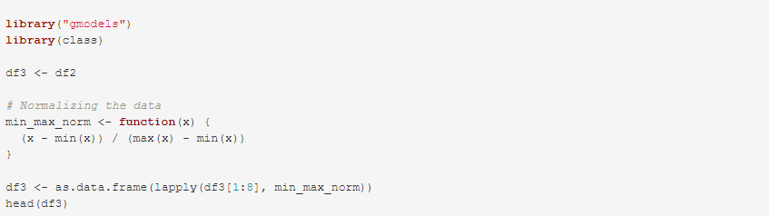
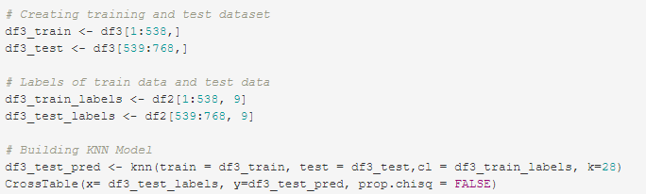
PREDICTIVE ANALYTICS USING SUPERVISED LEARNING
KNN MODEL ON DIABETES DATASET: R CODE (1/2)
Notes:
http://www.prnewswire.com/news-releases/patient-monitoring-devices-global-markets-300293102.html
http://www.marketsandmarkets.com/Market-Reports/patient-healthcare-monitoring-systems-devices-market-678.html
http://www.grandviewresearch.com/industry-analysis/digital-patient-monitoring-devices-market
http://www.census.gov/content/dam/Census/library/publications/2016/demo/p95-16-1.pdf
https://www.nia.nih.gov/newsroom/2016/03/worlds-older-population-grows-dramatically
http://americas.nttdata.com/Industries/Industries/Healthcare/~/media/Documents/White-Papers/Trends-in-Telehealth-White-Paper.pdf
https://globenewswire.com/news-release/2016/06/16/849108/0/en/Global-Patient-Monitoring-Equipment-Device-markets-to-reach-26-2-billion-by-2022-Making-a-market-resurgence-due-to-Modular-structure-ResearchMoz.html
http://www.prnewswire.com/news-releases/patient-monitoring-deviceequipmentsystem-market-worth-24762-million-usd-by-2020-565633001.html
http://www.24x7mag.com/2015/07/global-patient-monitoring-systems-market-worth-31-4-billion-report-estimates/
http://www.prnewswire.com/news-releases/patient-monitoring-deviceequipmentsystem-market-by-product-end-user---global-forecast-to-2020-300213927.html

Slide 21
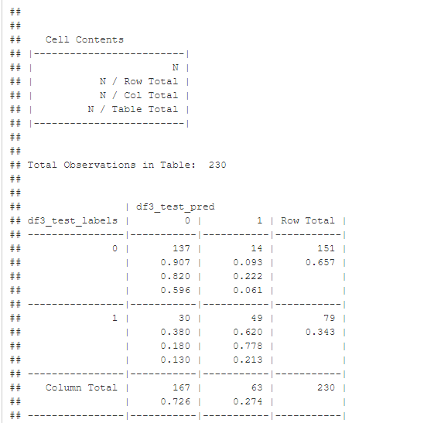
PREDICTIVE ANALYTICS USING SUPERVISED LEARNING
KNN MODEL ON DIABETES DATASET: R CODE (2/2)
Accuracy: (137 + 49) / 230 = 80.9%
Initial value of K was set to 28 which is the square root of total number of observations = 768
Initial value of K was set to 28 which is the square root of total number of observations = 768
Notes:
http://www.prnewswire.com/news-releases/patient-monitoring-devices-global-markets-300293102.html
http://www.marketsandmarkets.com/Market-Reports/patient-healthcare-monitoring-systems-devices-market-678.html
http://www.grandviewresearch.com/industry-analysis/digital-patient-monitoring-devices-market
http://www.census.gov/content/dam/Census/library/publications/2016/demo/p95-16-1.pdf
https://www.nia.nih.gov/newsroom/2016/03/worlds-older-population-grows-dramatically
http://americas.nttdata.com/Industries/Industries/Healthcare/~/media/Documents/White-Papers/Trends-in-Telehealth-White-Paper.pdf
https://globenewswire.com/news-release/2016/06/16/849108/0/en/Global-Patient-Monitoring-Equipment-Device-markets-to-reach-26-2-billion-by-2022-Making-a-market-resurgence-due-to-Modular-structure-ResearchMoz.html
http://www.prnewswire.com/news-releases/patient-monitoring-deviceequipmentsystem-market-worth-24762-million-usd-by-2020-565633001.html
http://www.24x7mag.com/2015/07/global-patient-monitoring-systems-market-worth-31-4-billion-report-estimates/
http://www.prnewswire.com/news-releases/patient-monitoring-deviceequipmentsystem-market-by-product-end-user---global-forecast-to-2020-300213927.html

Slide 22
Thank You
Nikhil Agarwal
MS BA Student at UC
agarwanh@mail.uc.edu

